Slide 1
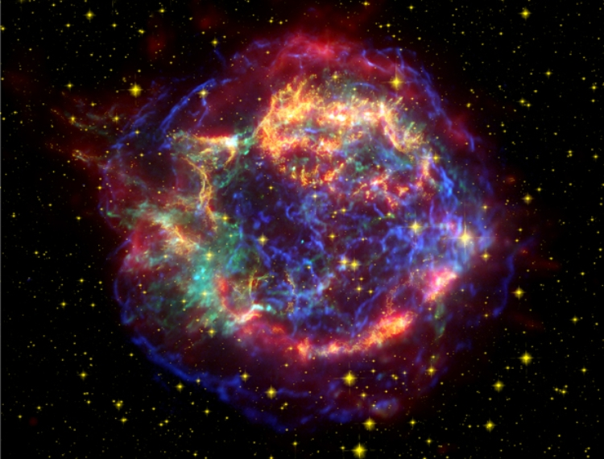
Cosmic Explosions
Creating the elements of life
Avishay Gal-Yam
Department of Particle Physics and Astrophysics
Weizmann Institute of Science

Slide 2
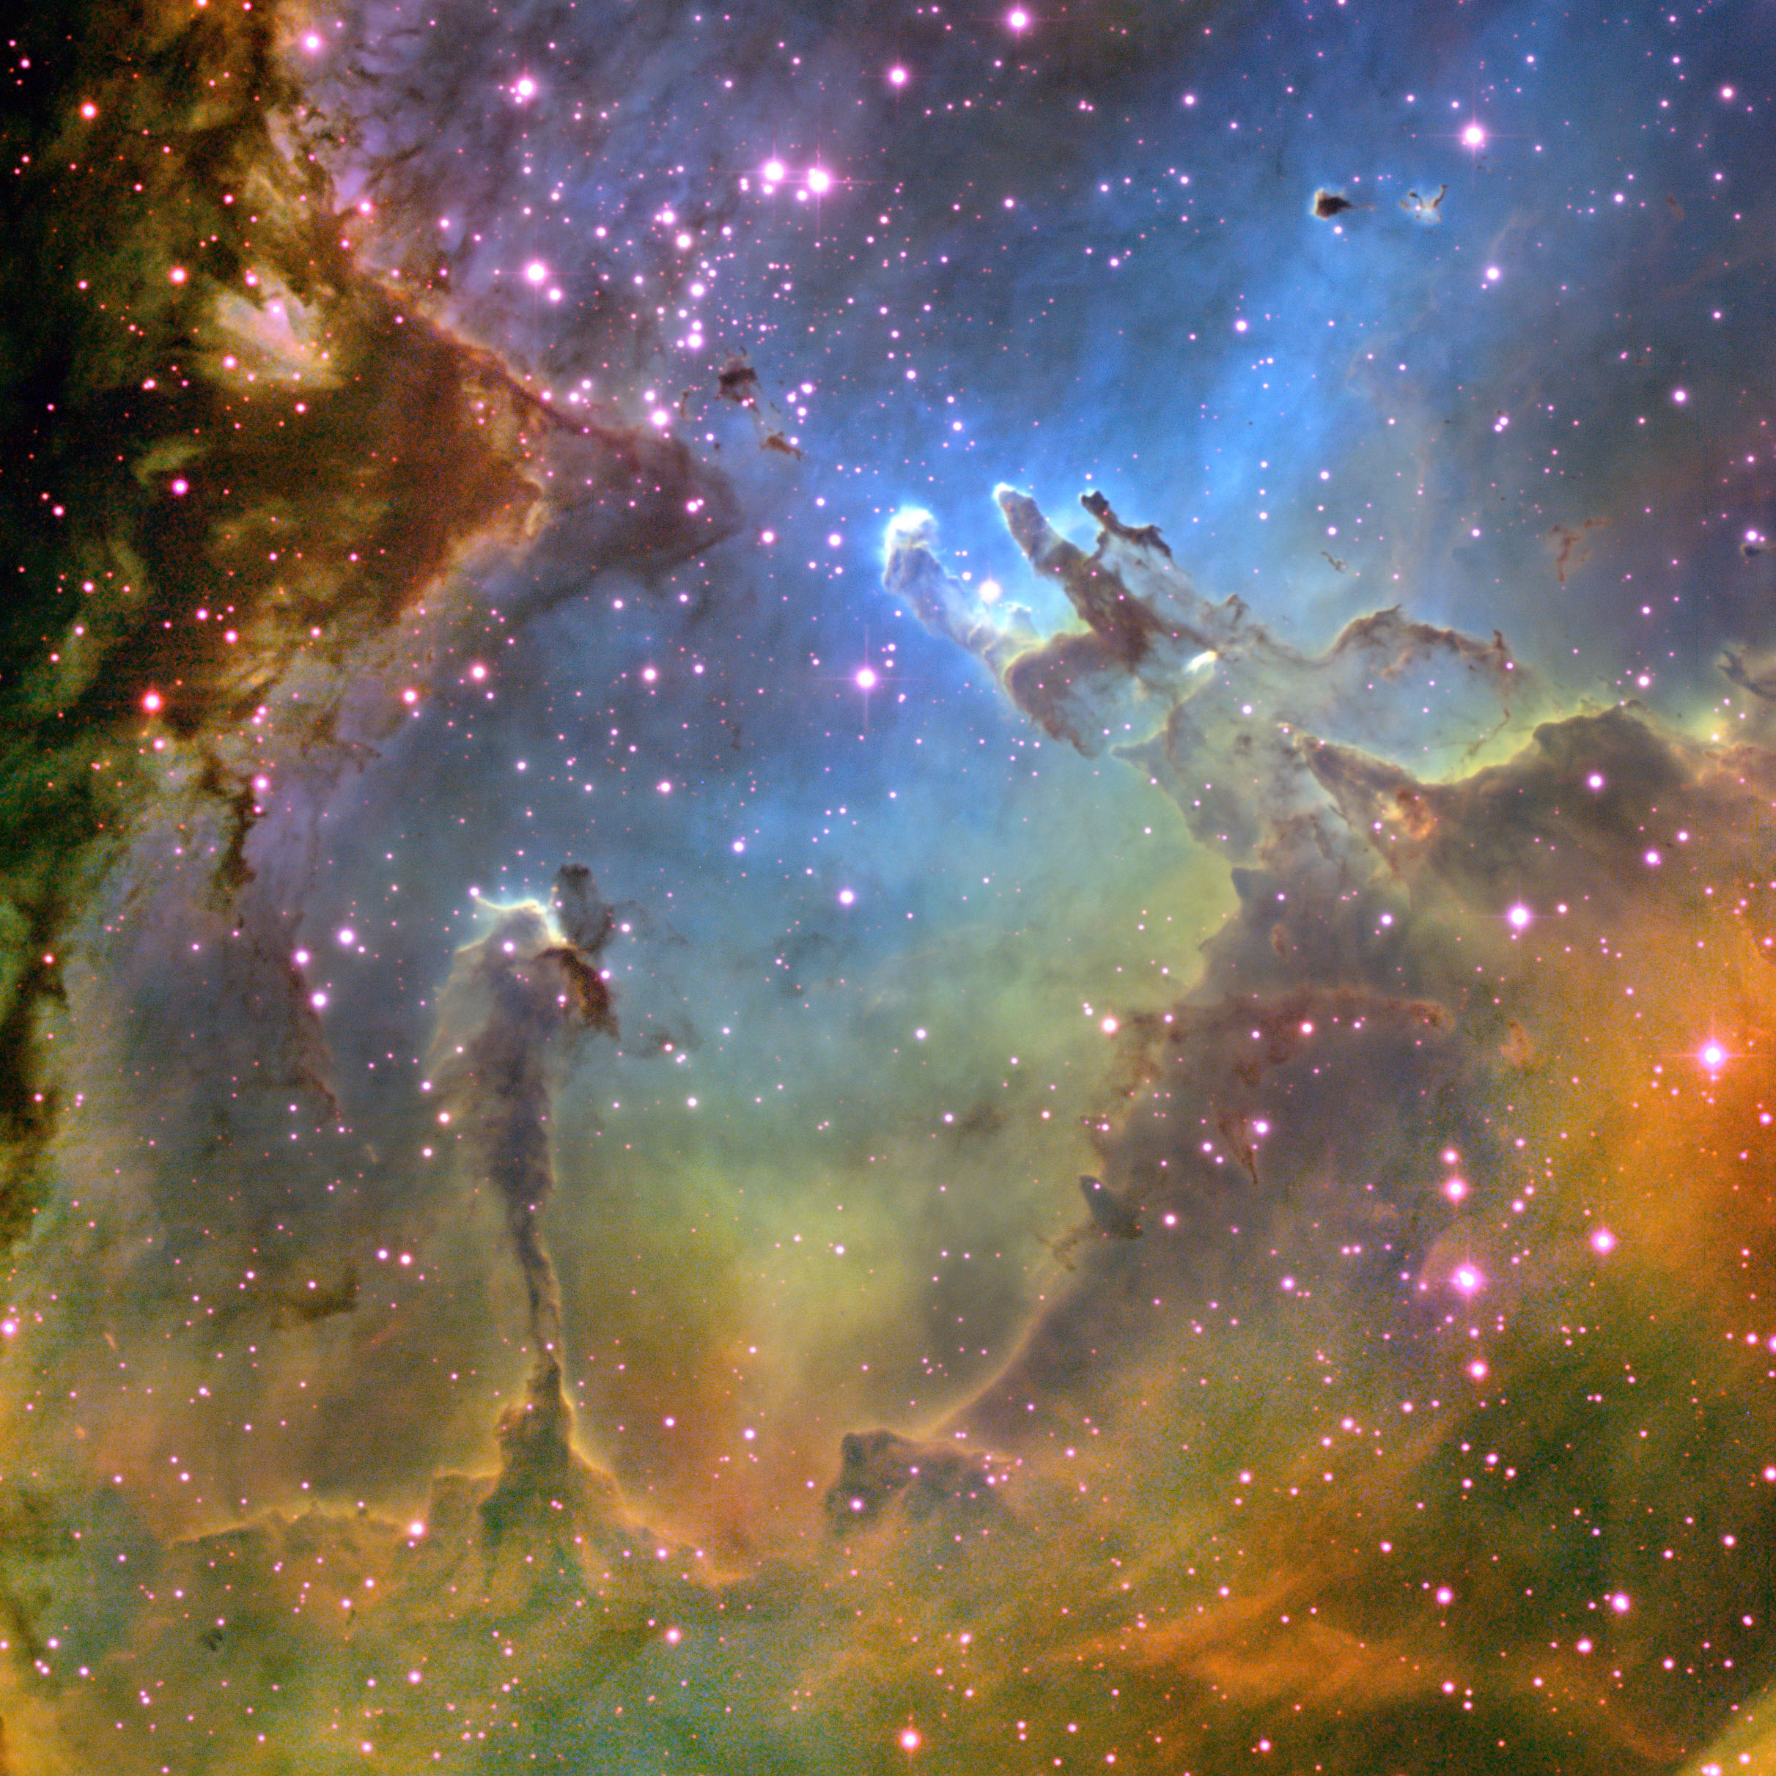
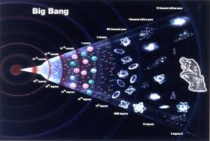
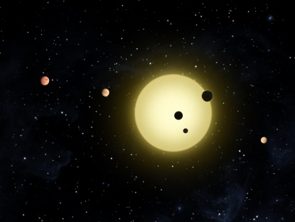
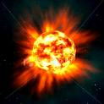
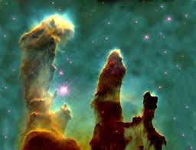
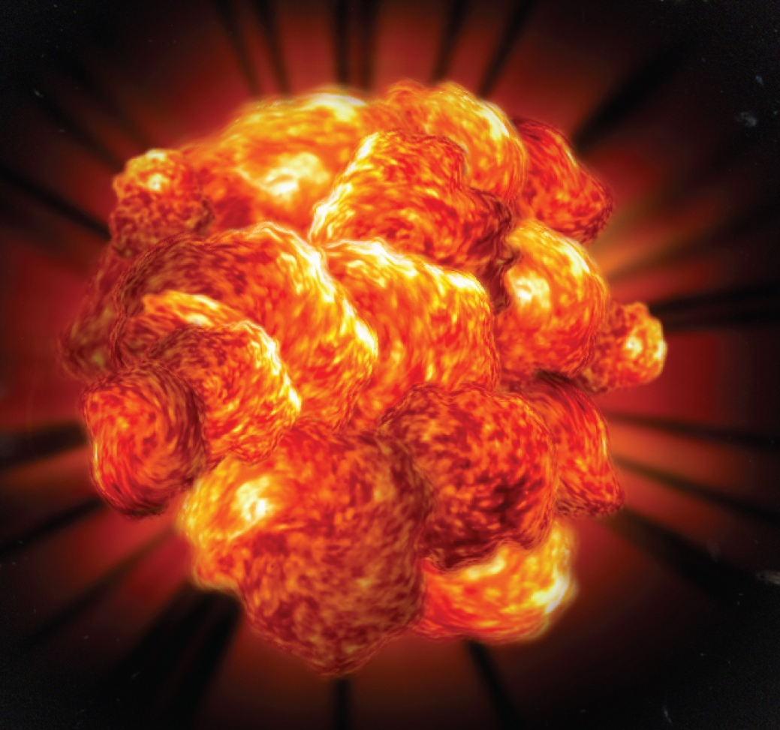
From Primordial Gas Clouds to Planets
The big bang
Rocky planets
Second generation
stars
First
generation stars
Element formation

Slide 3
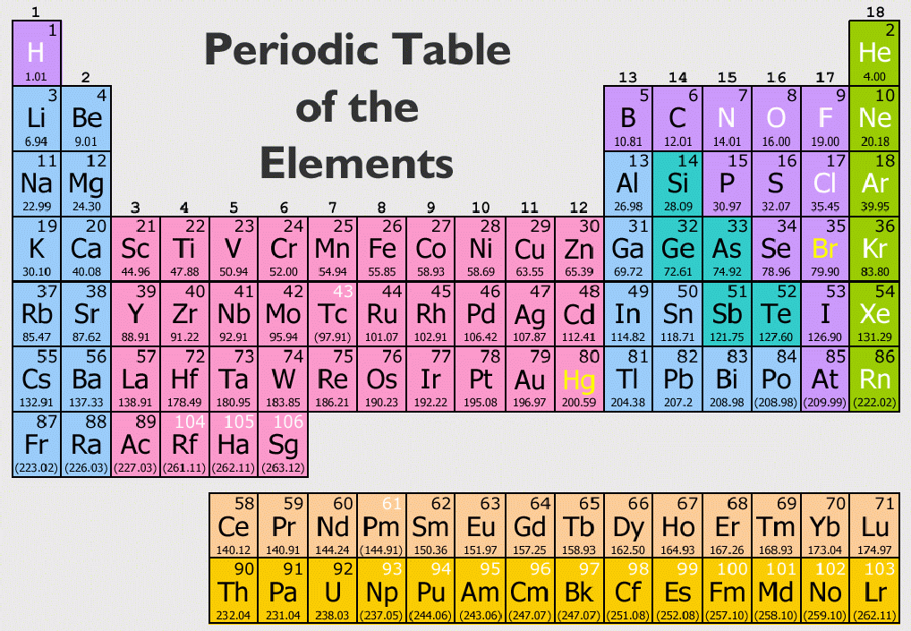
Origin of the elements

Slide 4
Nuclear fusion
P
N
P
N
P
P
Hydrogen
N
P
N
N
P
P
N
N
P
P
N
P
P
N
N
Carbon
Helium
N
N
P
P
P
N
N
P

Slide 5
Origin of the elements

Slide 6
Cosmic element factories

Slide 7
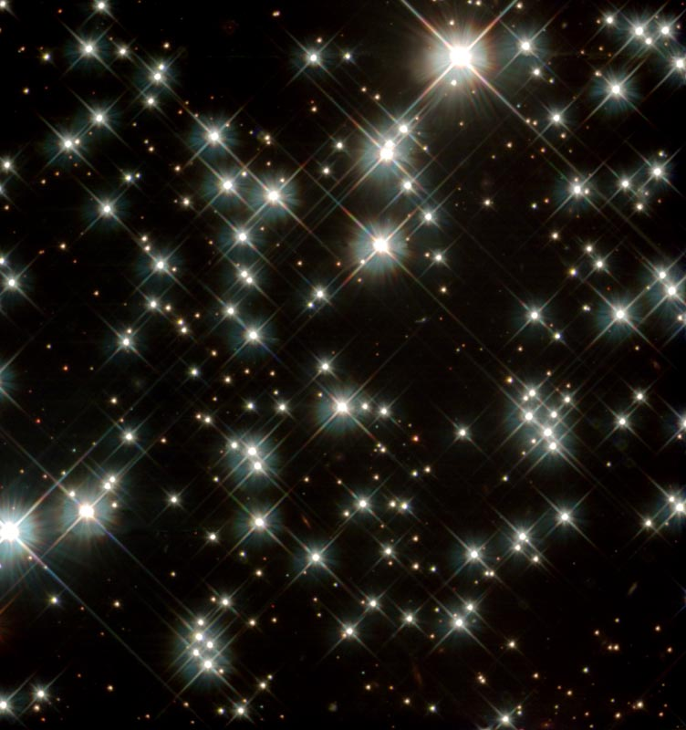
The first explosions (Gal-Yam et al. 2009, Nature, 462, 624)
We have recently discovered the first example of a pair-instability supernova
Theoretical prediction from 1967 (Shaviv, Rakavy, Barkat)
The explosion of the most massive stars (over 150 solar)
The first cosmic element factories

Slide 8
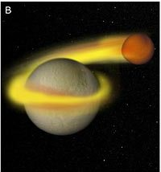
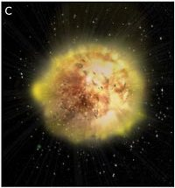
Making
Calcium
(and titanium)
C/O
He
Calcium
Perets et al. 2010
(Nature, 465, 322)

Slide 9
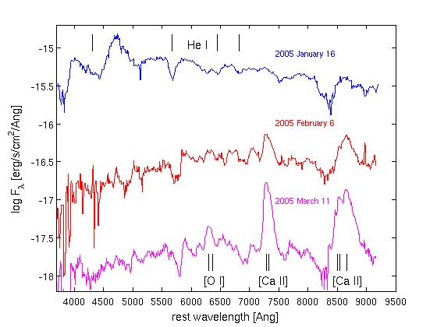
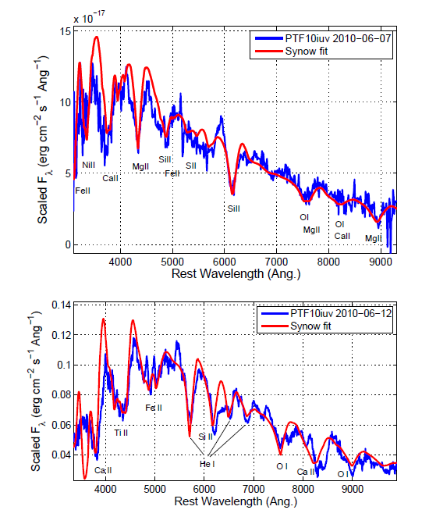
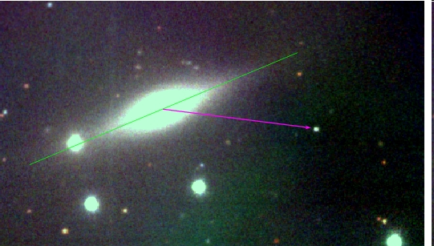
The curious case of SN 2005E (Perets, Gal-Yam and collaborators, Nature 2010)
Kasliwal, Yaron

Slide 10
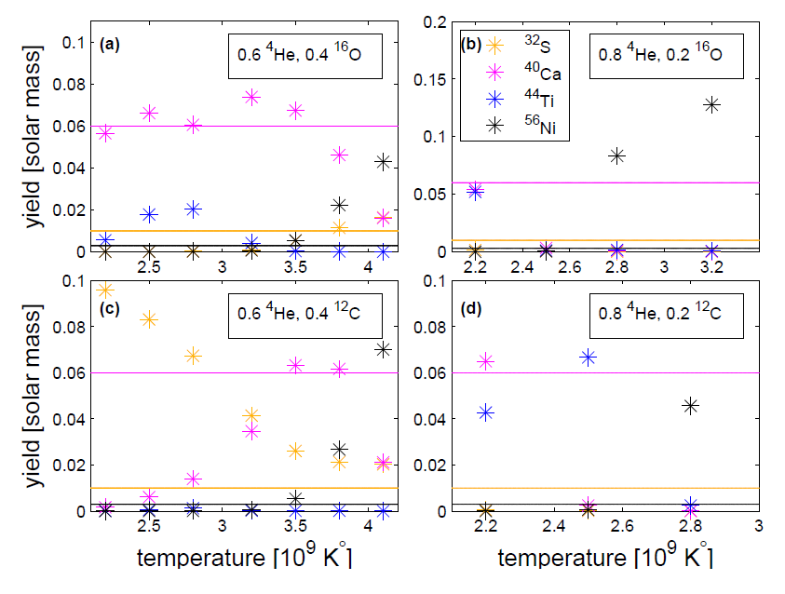
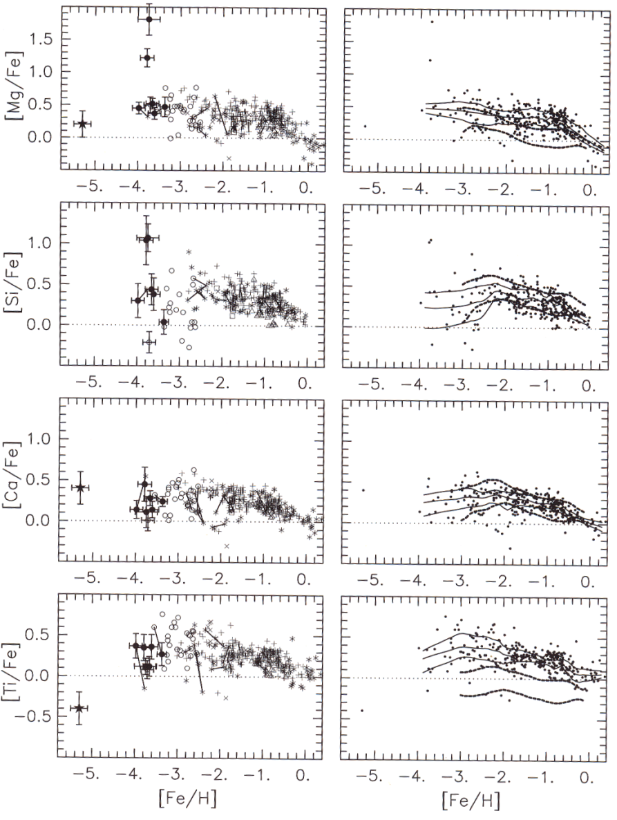
The origin of titanium (Perets et al. 2010, Nature)
Measured elemental abundances in stars show a systematic titanium excess
The models are based only on element yields from known supernova types
The new type of explosion we discovered may well explain most of the titanium in nature (and also some of the calcium)
model
→ more iron

Slide 11
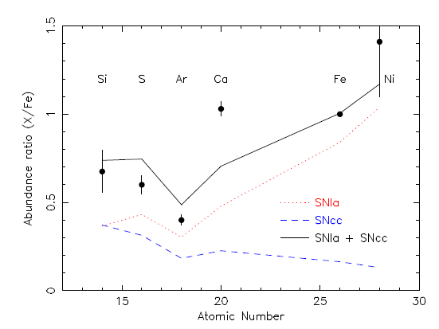
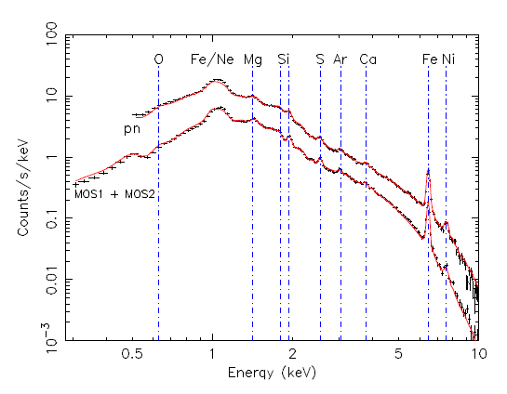
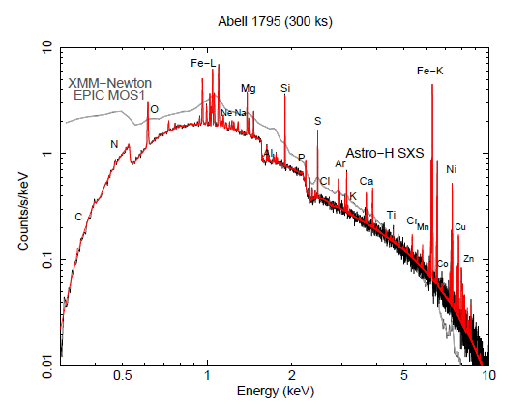
What about calcium
→מגנזיום
→טיטניום
מודל
→כמות הברזל בכוכב
De Plaa et al. 2012

Slide 12
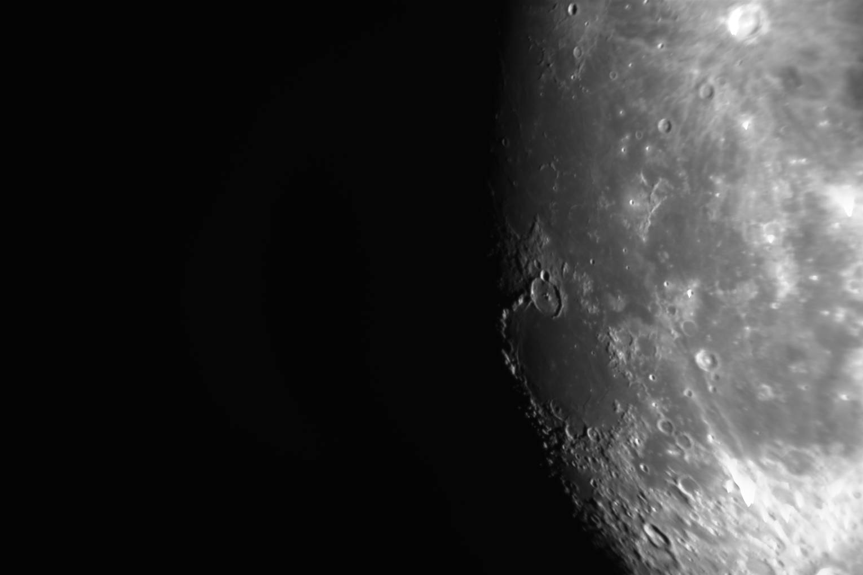
Conclusions
Cosmic explosions explain the origin of the elements, including the building blocks of life
This is not a solved problem!
New studies illuminate the history of element formation (starting shortly after the big bang) as well as origin of specific elements

Slide 13
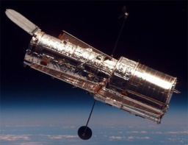
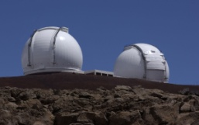
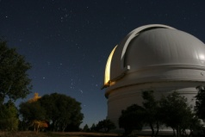
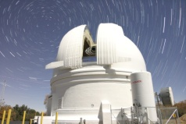
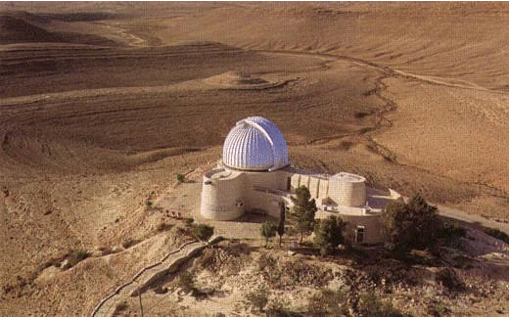
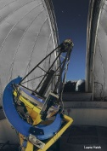
An era of discoveries … Thanks!

