Slide 1
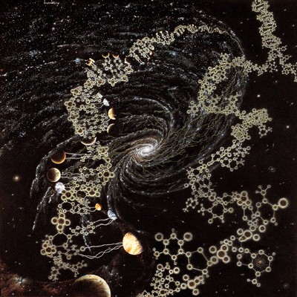
How frequent are biotic worlds?
The Impact of Kepler on the likelihood
of Extra-terrestrial Life
Amri Wandel - Hebrew Univ. of Jerusalem

Slide 2
How frequent are terrestrial exo-planets?
Do other stars have planets?
If so, are they Earthlike?
Are they in the Habitable zone?
The exo-planet boom
What has changed with Kepler?

Slide 3
Star types suitable for the evolution of life
Too big(M>1.5Mo)- Main Sequence lifetime insufficient for the evolution of life
Too small (<0.5 Mo) - eruptive (planetary temperature instable)
This leaves ~ 10% of all stars.

Slide 4
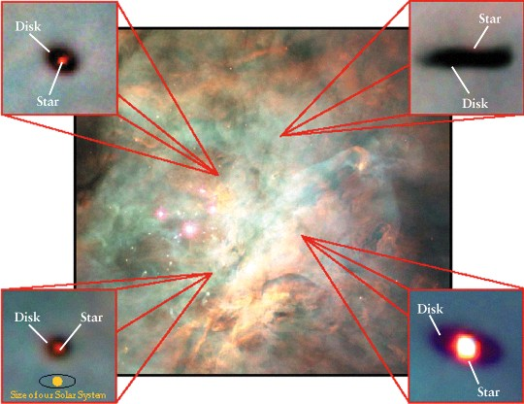
Planetary disks being born in Orion
עוברי כוכבים ו”מערכות שמש” בערפילית אוריון

Slide 5
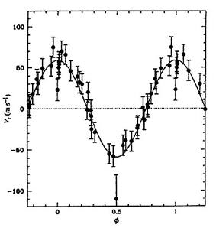
V*~m_{p} a_{p}^{-1/2} 51 Peg
The Doppler method

Slide 6
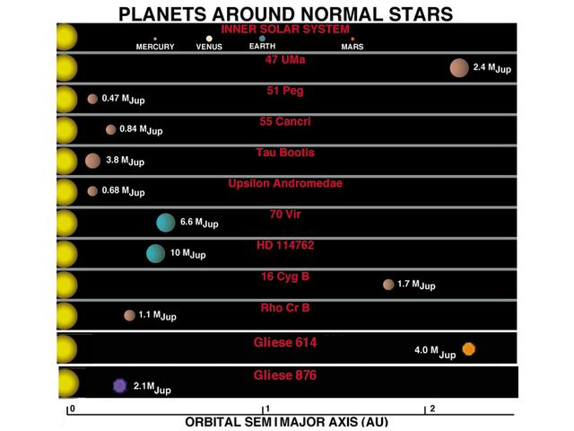
Doppler method is biased towards massive,near planets

Slide 7
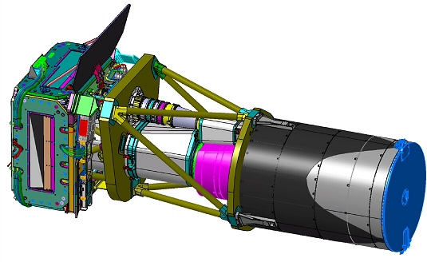
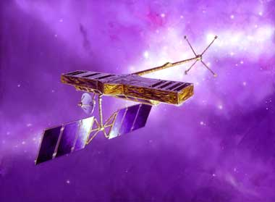
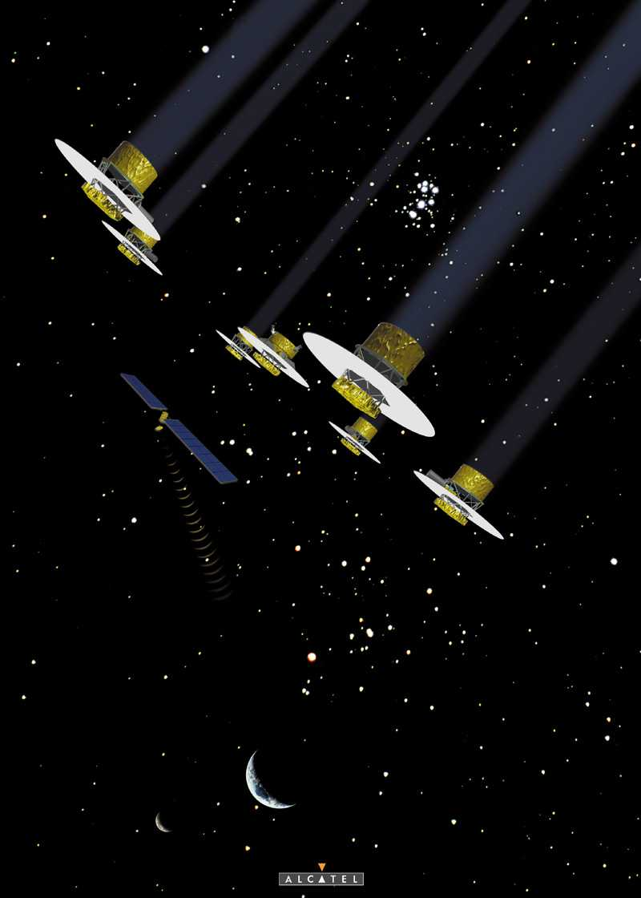
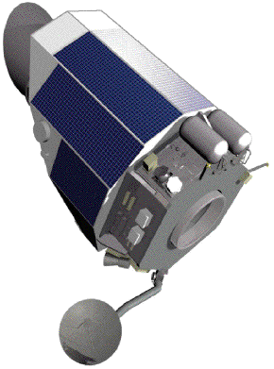
Observatories in Space
CoRoT
Darwin
SIM
Kepler

Slide 8
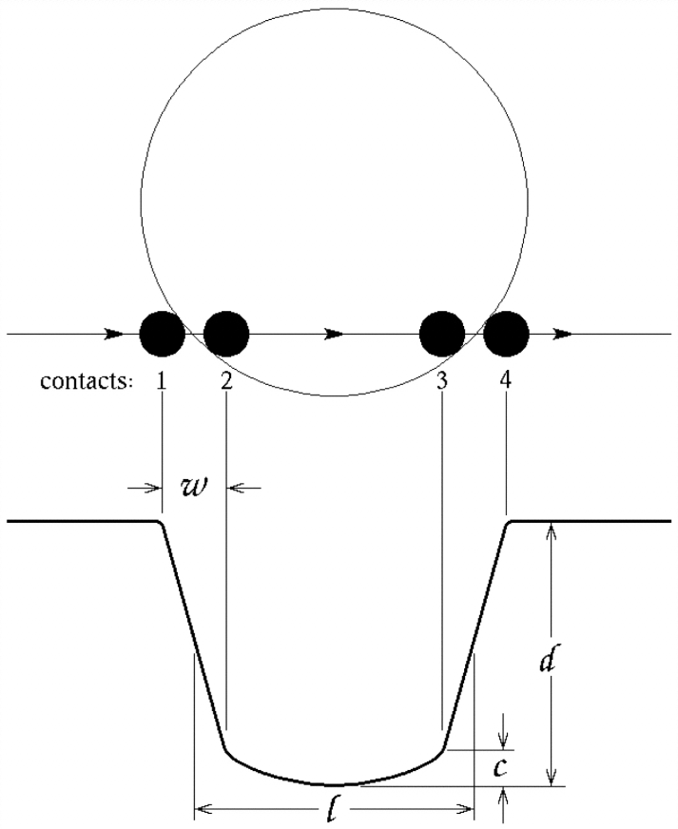
The transit method
The inclination must be very close to 90°

Slide 9
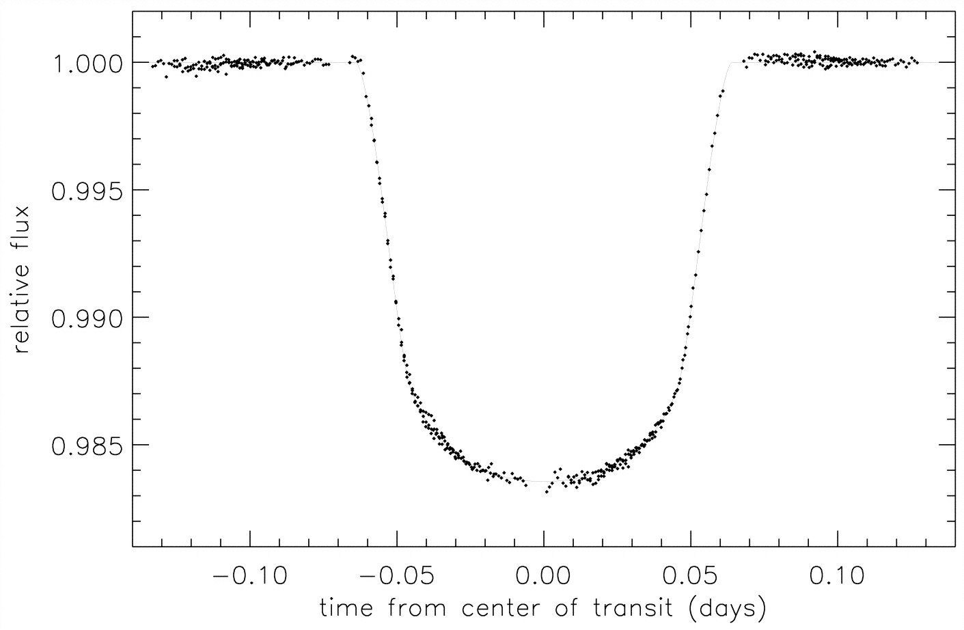
HD209458
Planet mass
Planet radius
Planet density

Slide 10
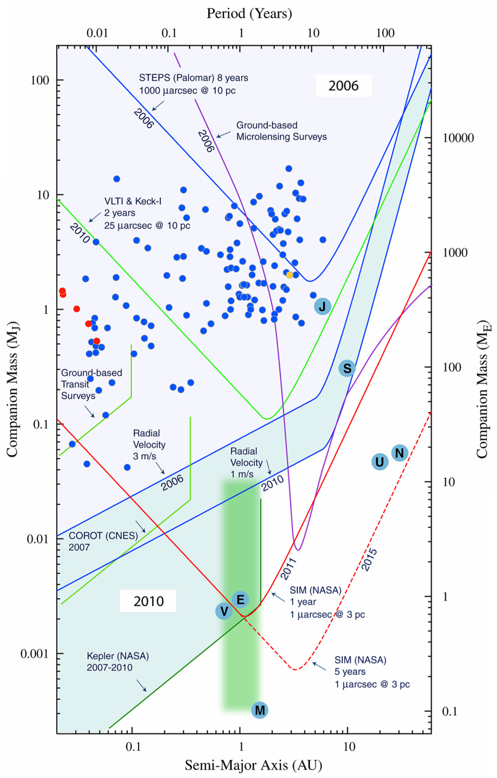
Sensitivity of exo-planet projects
Radial velocity (Doppler)
Transit
Micro-lensing

Slide 11
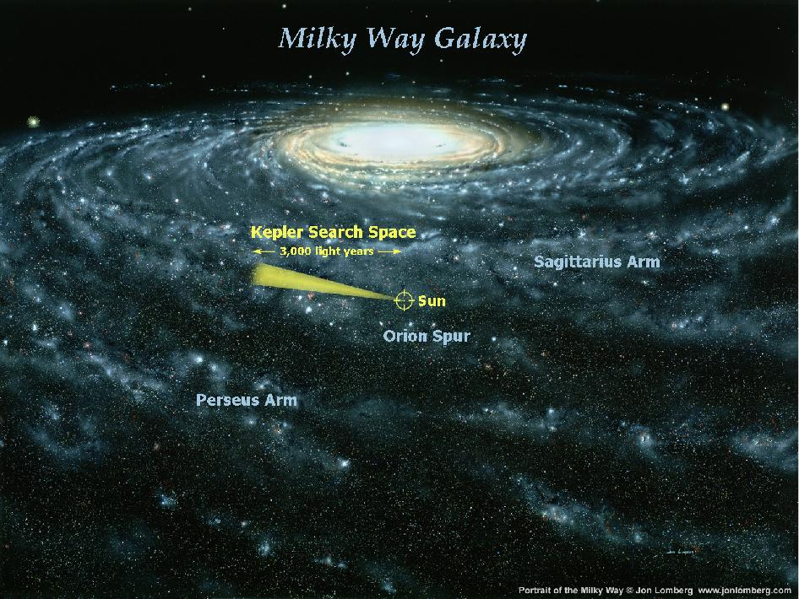
The Kepler mission
Search Earthlike exo-planets

Slide 12
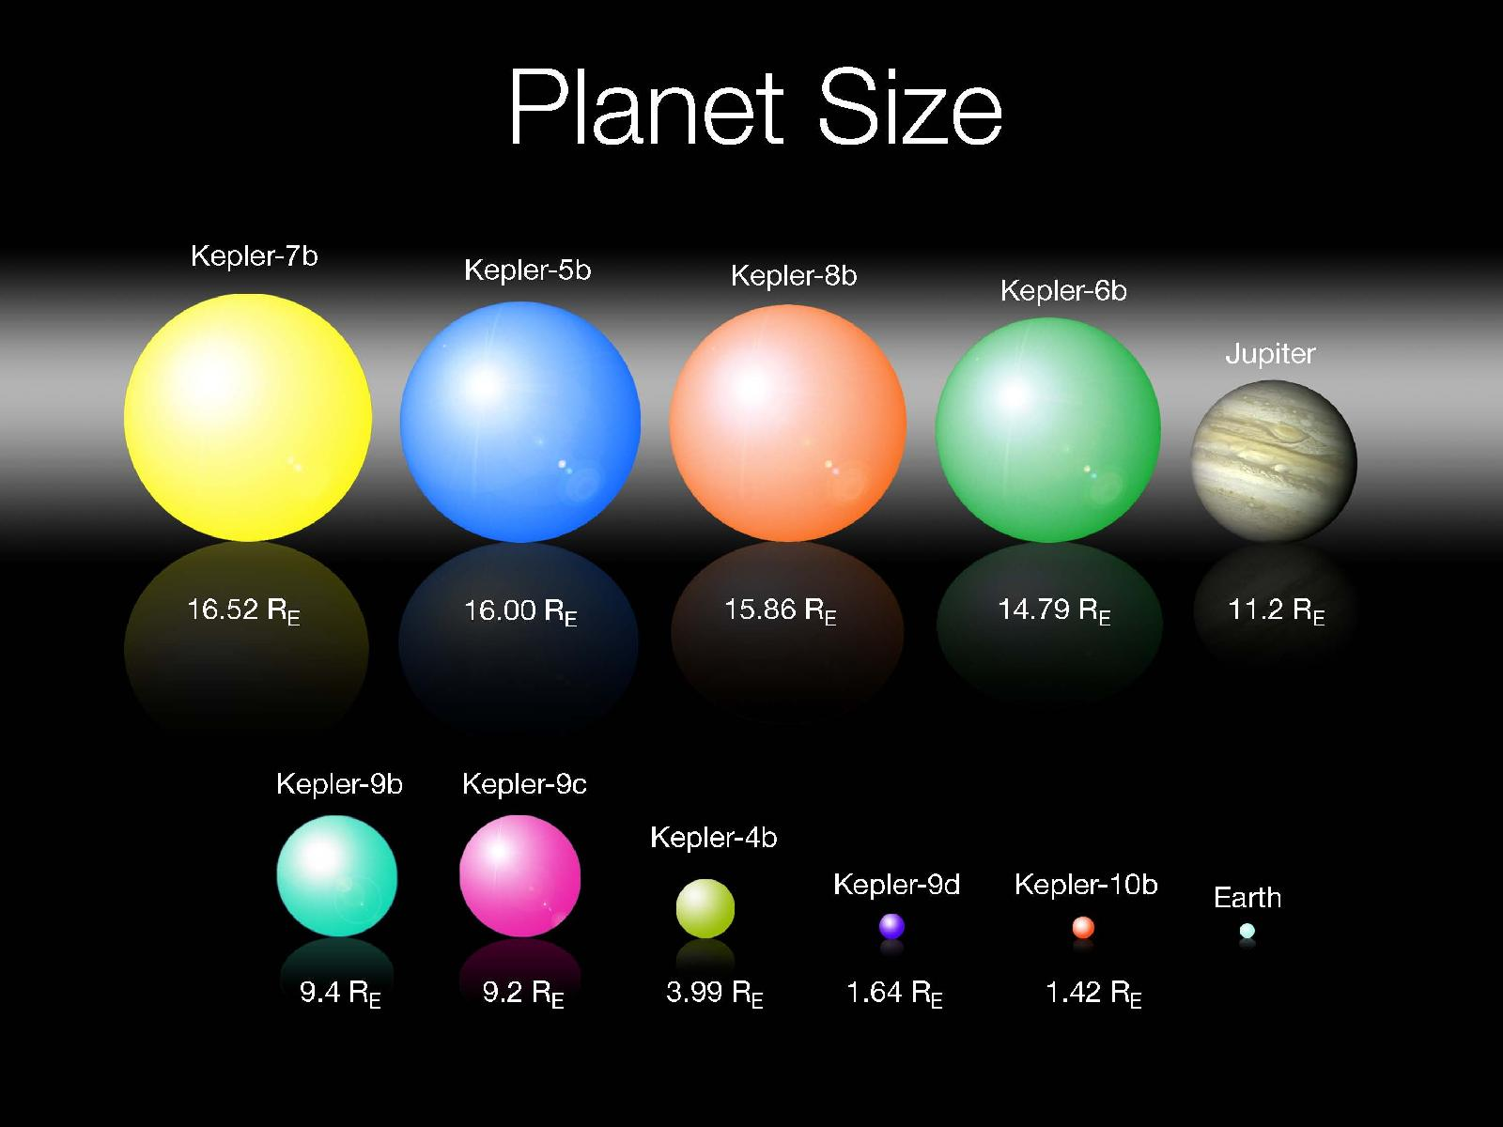
Kepler’s first planets

Slide 14
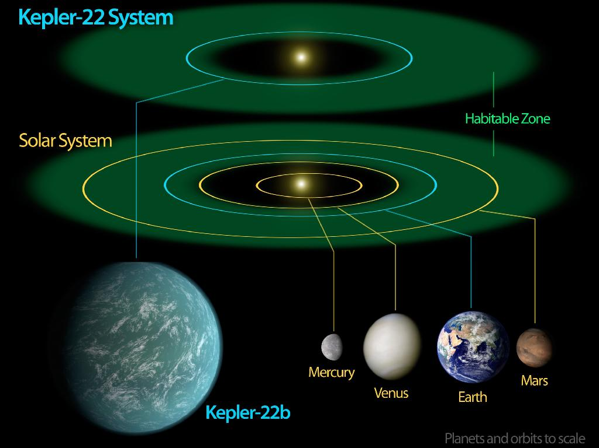
The Habitable Zone

Slide 15
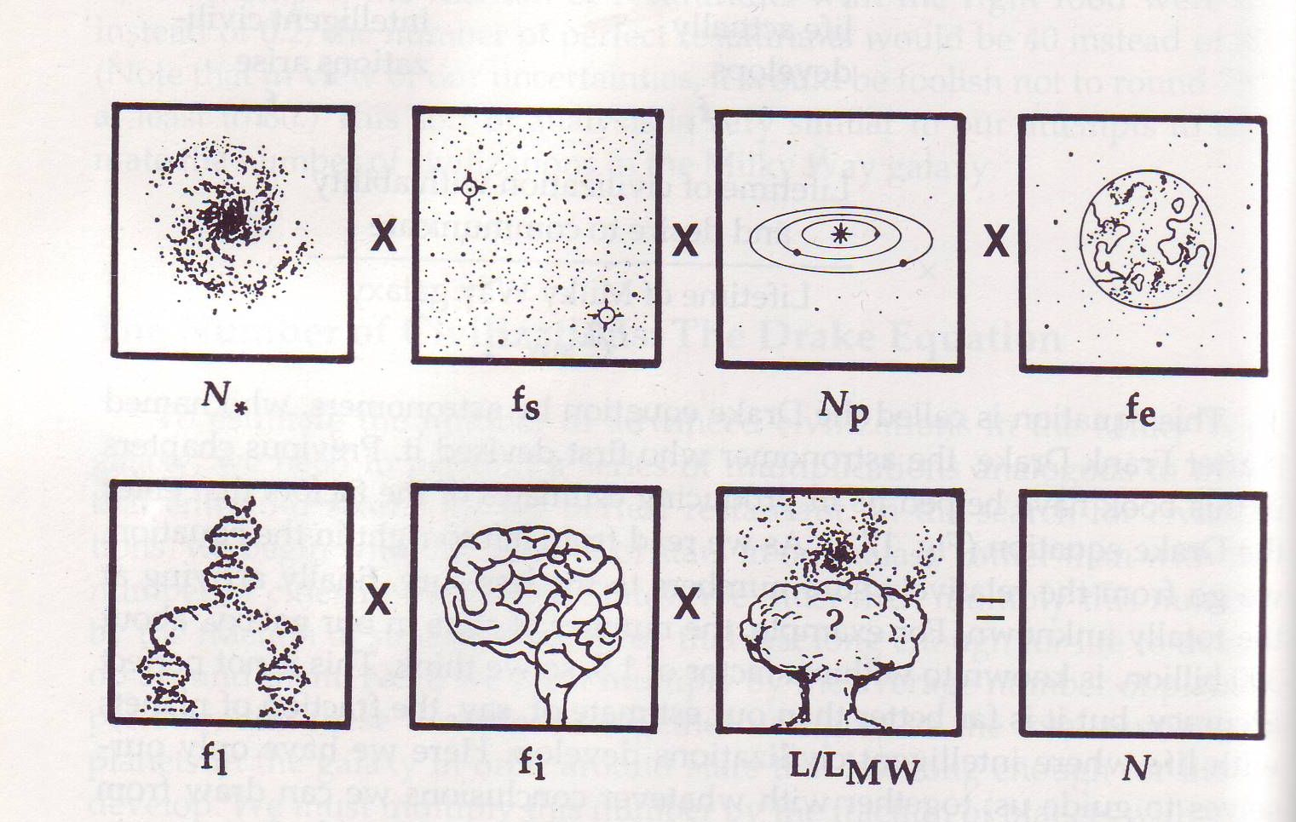
How many biotic woldss exist in the Galaxy ?
?
?
Kepler 20e,f
19.12.2011
Kepler 22b
5.12.2011
10¹¹ stars 10% Sunlike Planets in HZ Earthlike
n_{HZ}

Slide 16
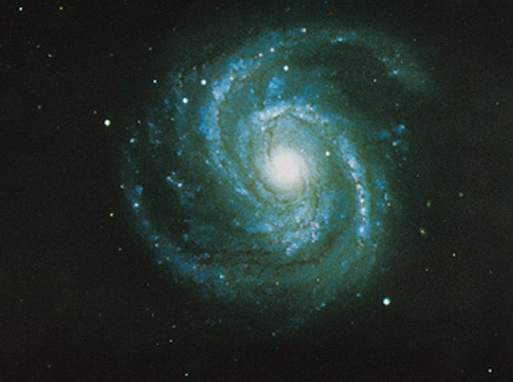
How frequent is extra-terrestrial life?

Slide 17
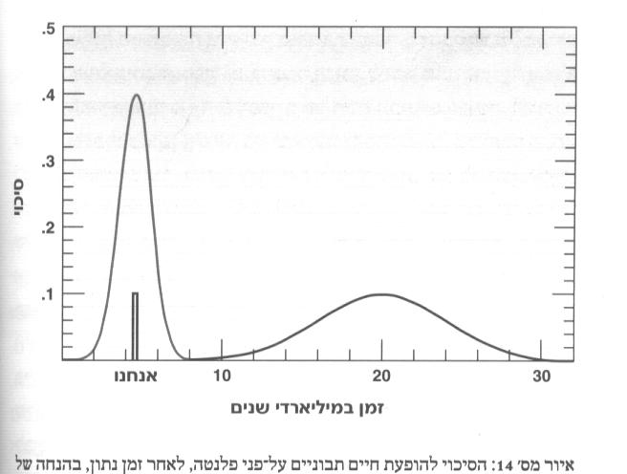
Probability for a terrestrial planet to become biotic vs. cosmic time
probability
Earth
Time (bill.yrs)

Slide 18
Probabilities for terrestrial planets and biotic worlds
Average distance to nearest biotic exoplanet:
D_{b}~10 ly (F_{p}F_{b}) ^{-1/3}
Let’s assume two extreme scenarios:
Optimistic: F_{p}=1, F_{b}=1, D_{b}~10 ly
Pessimistic: F_{p}=0.01, F_{b}=0.001 D_{b}~500 ly

Slide 19
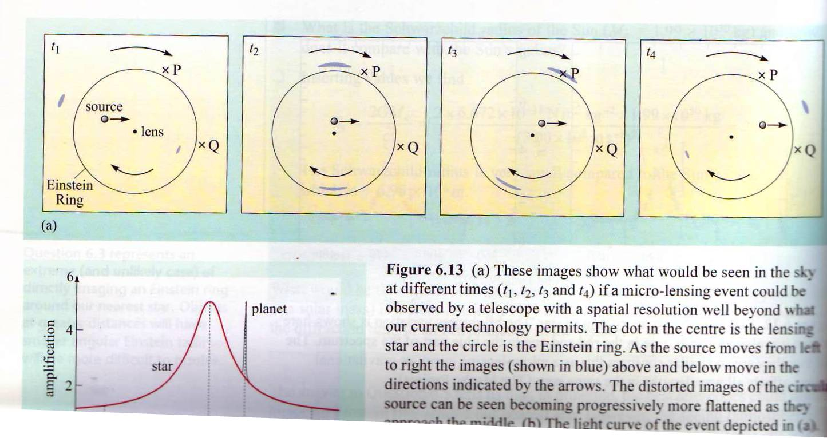
Exo-Planets by Micro-lensing

Slide 20
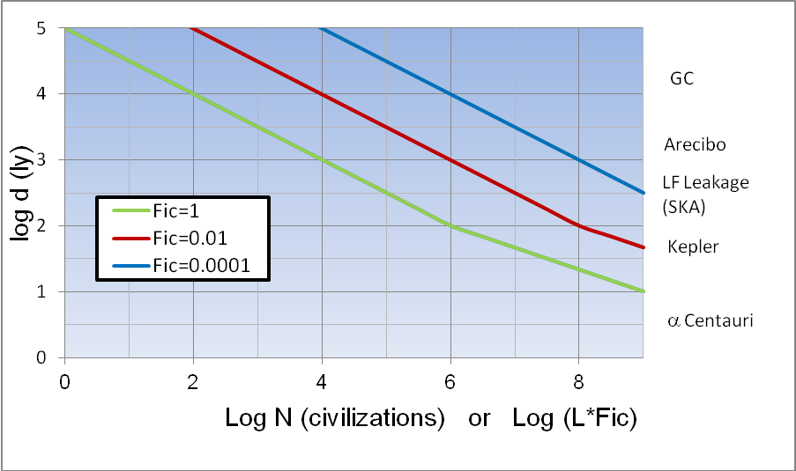
Distance to nearest biotic planet
11+Log (FpFb)

Slide 21
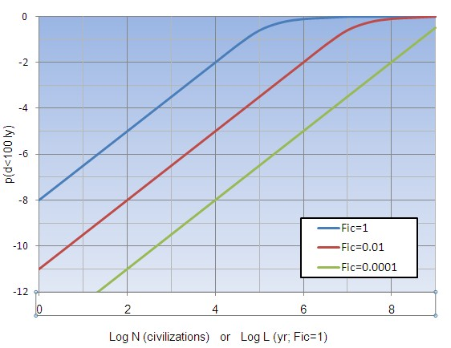
Probability for a biotic planet within 100 ly
11+Log (FpFb)

Slide 22
Seems to be much more likely
After Kepler
extra-terrestrial life

